Slide 1
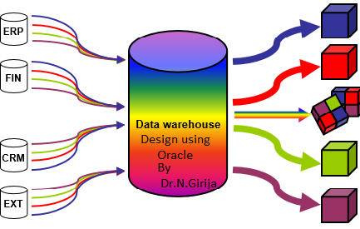
Data warehouse Design Using Oracle
https://www.oercommons.org/authoring/edit/21861
OER- UNIT 5 SQL MODEL CLAUSE

Slide 2
Part 1- SQL model clause

Slide 3
With the SQL model clause you build one or more matrixes with a variable number of dimensions. This is called the model.
The model uses a subset of the available columns from your FROM clause.
It contains at least one dimension, at least one measure and optionally one or more partitions
create table salesorder(ord number(4) primary key,prodno number(3),suppno number(3),time number(5),location varchar2(20),sales number(6));

Slide 4
Ord | Prodno | Suppno | Time | Location | sales
1 | 1 | 1 | 2000 | Sohar | 5
2 | 1 | 1 | 2000 | Muscat | 3
3 | 1 | 1 | 2001 | Sohar | 6
4 | 1 | 1 | 2001 | Muscat | 4
5 | 1 | 2 | 2000 | Sohar | 1
6 | 1 | 2 | 2000 | Muscat | 7
7 | 1 | 2 | 2001 | Sohar | 8
8 | 1 | 2 | 2001 | Musat | 5
9 | 2 | 1 | 2000 | Sohar | 3
10 | 2 | 1 | 2000 | Muscat | 8
11 | 2 | 1 | 2001 | Sohar | 6
12 | 2 | 1 | 2001 | Muscat | 7
13 | 2 | 2 | 2000 | Sohar | 9
14 | 2 | 2 | 2000 | Muscat | 11
15 | 2 | 2 | 2001 | Sohar | 4
16 | 2 | 2 | 2001 | Muscat | 3

Slide 5
Partition columns
Partition columns divide the result set into blocks. Rules defined in the model clause are applied independently of other partitions to each partition.
Dimension columns
Dimension columns define how cells within a partition can be accessed.
Measure columns
The columns defined as measures can be assigned new values in the rules section of the model clause.

Slide 6
Part 2- Dimension by
Unique column

Slide 7
Dimension by
Unique column
Multi dimension column
Aliasing
Expression

Slide 8
In the model clause, the dimension components are used to define multi-dimension array and it is also useful for identifying cells or column within the partition.
By default it will identify at least one cell in a partition
The dimension components have the column name which has unique value

Slide 9
Query | Output
Select ord, sales from salesorder Where time=2000 model dimension by(ord) measures(sales) rules() order by ord; | ORD SALES ---------- ---------- 1 5 2 3 5 1 6 7 9 3 10 8 13 9 14 11 8 rows selected.

Slide 10
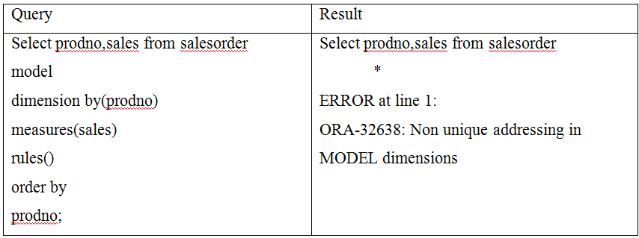
Column value given in the dimension is not unique then it will give "non unique addressing" error.

Slide 11
Part 3- Dimension by
Multiple dimension using unique keys

Slide 12
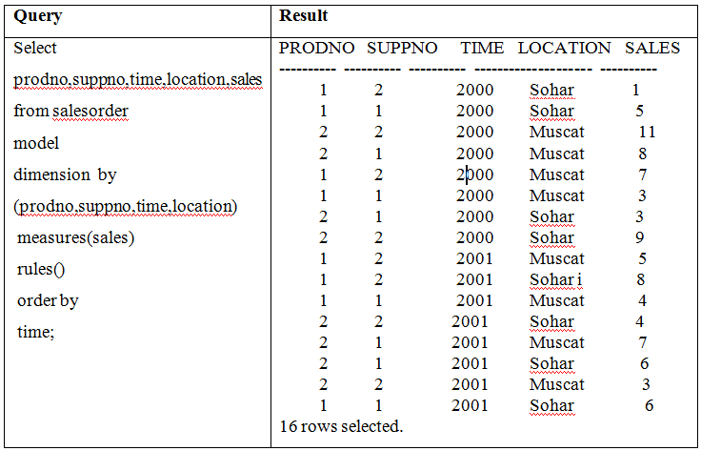
It is possible to use more than one dimension column be specified.
But all the combination gives the unique row identification

Slide 13
Part 4- Dimension by
aliasing

Slide 14
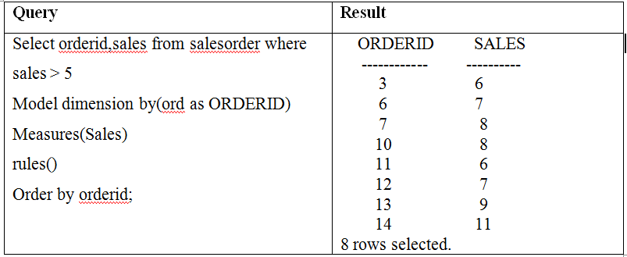
In the result set, the user desired column name can be displayed by using aliasing "as" in the dimension.

Slide 15
Part 5- Dimension by
Expression

Slide 16
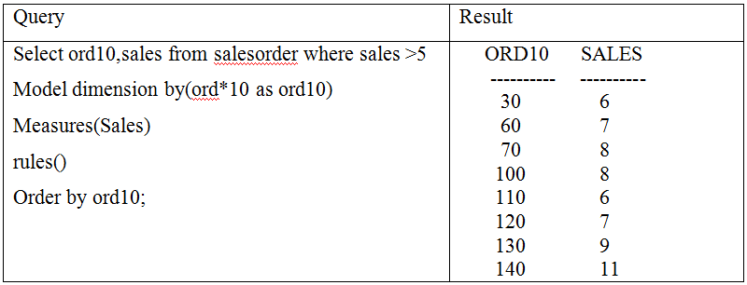
It is possible to use expression in the dimension component.
In the given query, value of the ord column is multiplied by 10. So, column value 3 is displaying as 30.

Slide 17
Part 6-sql model clause
Measures

Slide 18
Measure is a data column of the table.
It is similar to measure in the star schema based fact table.
Generally measures have numeric based values like cost or amount.
Each cell or column mentioned in the measures is accessed by specifying its full combination of dimensions.

Slide 19
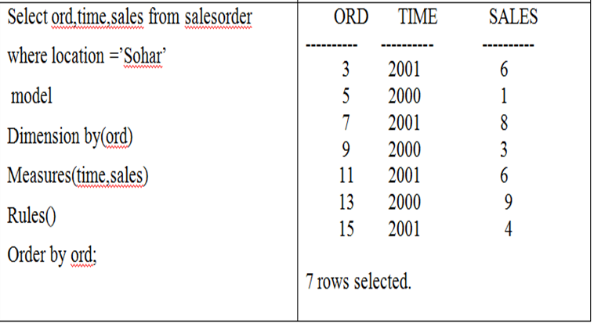

Slide 20
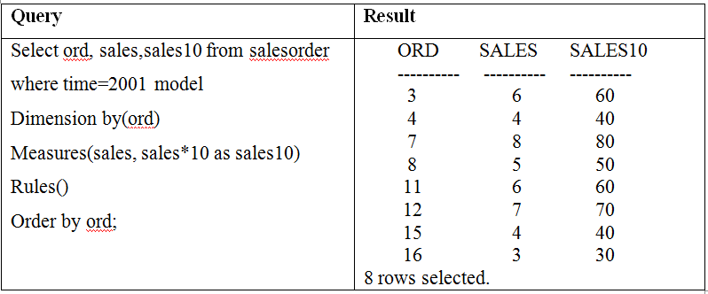
Like dimension it is possible to write expression in the measure column also.

Slide 21
Part 7-sql model clause
Partition by

Slide 22
The Oracle data warehousing describes partition as a logical block of the result set.
It is similar to how partition in the analytical functions.
Each partition is viewed by the formula mentioned in the partition by component and treated as an independent array.

Slide 23
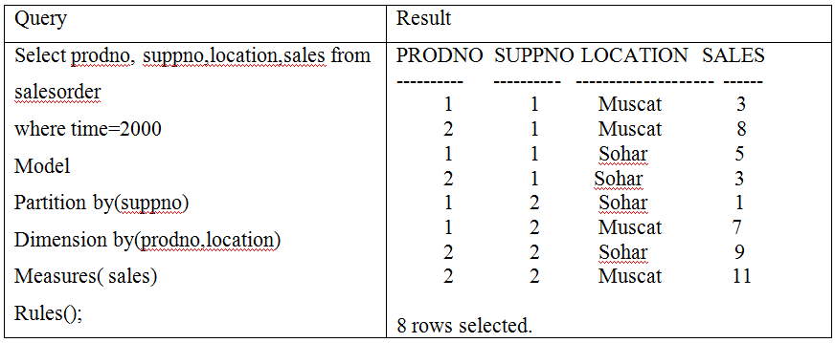

Slide 24
Part 8-sql model clause
Rules

Slide 25
In the model clause, rules hold the expressions that assign values to measures.
A rule is an assignment statement whose left side represents a cell or a range of cells and whose right side is an expression involving constants, bind variables or individual cell or aggregate function.
There are three terms used in rules namely
cell reference, dimension reference, cell assignment.

Slide 26
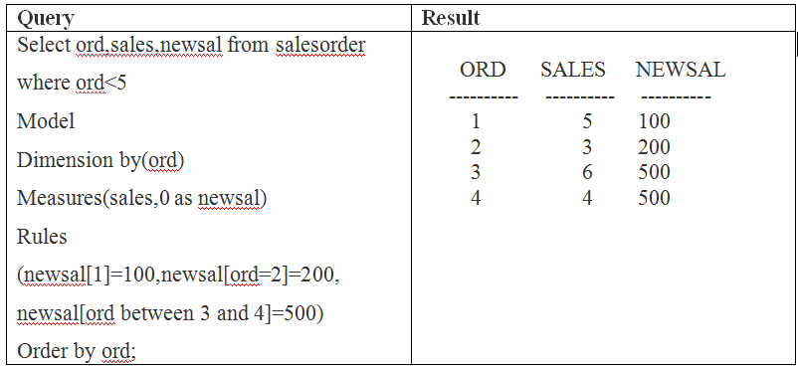

Slide 27
The term "newsal" is called a "cell reference, Cell references (i.e newsal) can only refer to measure cells, not dimension cells.
The dimension reference is part between the square bracket [] in the cell reference
When a cell reference is used as the assignment target on the left side of a rule equation is called cell assignment.
newsal[1]=100
Cell Assignment
Cell reference ,it refers measures
Dimension reference

Slide 28
Part 9-sql model clause
Rules
create new row

Slide 29
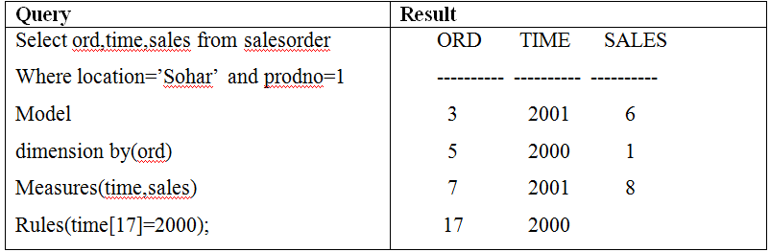
The RULES clause also used to create new rows in the result set

Slide 30
Adding values to newly created row
It is also possible to add values to newly created row by using Rules Clause
Query | Result
Select ord,time,sales from salesorder Where location=’Sohar’ and prodno=1 Model dimension by(ord) Measures(time,sales) Rules(time[17]=2002,sales[17]=8); | ORD TIME SALES ---------- ---------- ---------- 3 2001 6 5 2000 1 7 2001 8 17 2002 8

Slide 31
Part 10-sql model clause
RETURN UPDATED ROWS

Slide 32
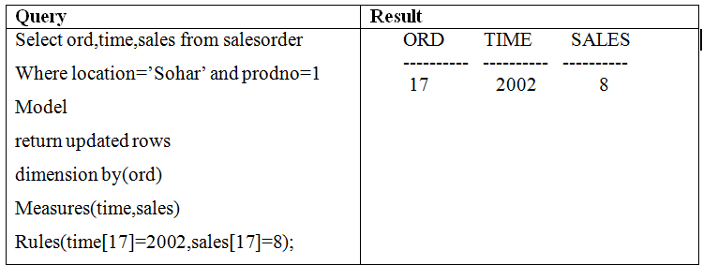
Suppose in the previous query the entire row those satisfying the condition location = Sohar and prodno=1. But the output will show newly created row or inserted row by using rule clause, then use “return updated rows”. Then it will display only the newly created row.

Slide 33
Part 11-sql model clause
RETURN All ROWS

Slide 34
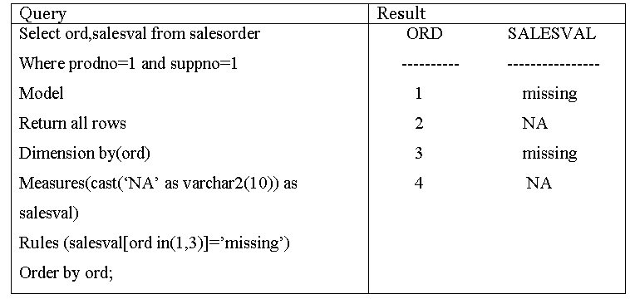
By default “return all rows” is used in the model queries Rules clause. Generally if it is mentioned as return all rows also it will display both updated or non-updated rows also.

Slide 35
Part 12-sql model clause
Not use same column in dimension and measure

Slide 36
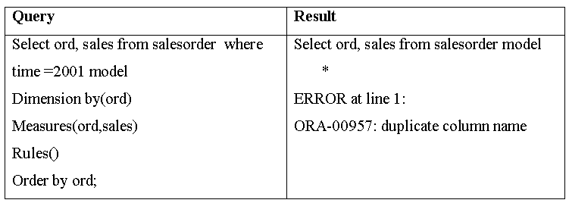
Same column for both a dimension and a measure are used in the given below query i.e "ord" column used in both measure and dimension. Therefore it is giving the error message.

Slide 37
Part 13-sql model clause
NULL not allowed in DIMENSION BY or MEASURES clauses

Slide 38
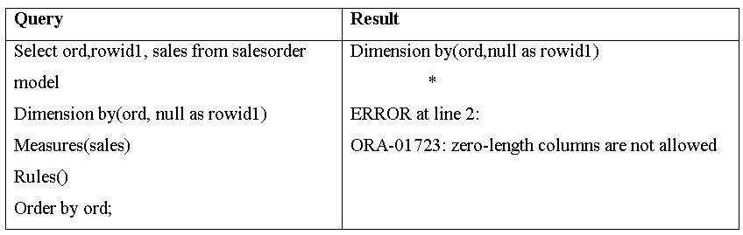
Null value not allowed in dimension. Because, in general dimension have primary key column name. So, it doesn't have null values. If null values are allowed then it is difficult to identify the cell i.e. a reason null value not allowed in the dimension. So, it is giving error message.

Slide 39
Part 14-sql model clause
Empty String (' ')

Slide 40
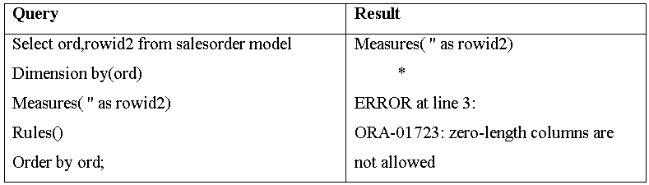
Empty string also not allowed in both dimension and measure. The purpose of the dimension and measure gives multi-dimensional based result set based on given column values. Then value is empty, the purpose is not fulfill. So, it is giving error message of empty string or empty column values.

Slide 41
Part 15-sql model clause
Using For Loop

Slide 42
Using Model clause, looping operation is possible. Using For constructs the single formula can generate multiple formulas with positional references and it is also used to create new values.
Using For construct can be used for dimension of numeric, date and date time data types.
Increment and decrement expression can be used in numeric dimensions and interval for dimensions are used date or date time data types. In the below query dimension has order id is numeric data type. Here it creates the new value to column Test.

Slide 43
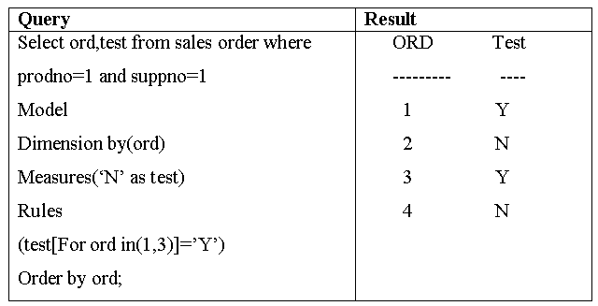

Slide 44
Part 15-sql model clause
ITERATION

Slide 45
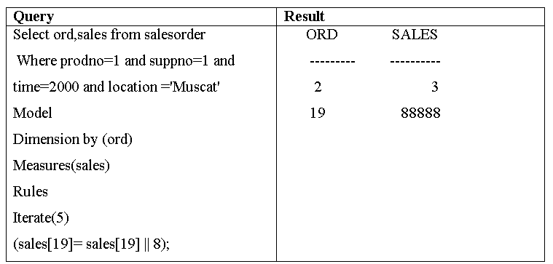
For repeating the rules for execution need iterate feature. In this example, sales [19] || 8 using rules creating new values for sales [19] and assigning value 8. This value will be execute exactly 5 times given as per condition in iterate (5) in sales [19].

Slide 46
Part 16-sql model clause
Iteration using until Clause

Slide 47
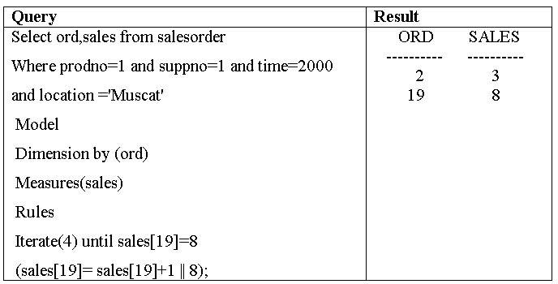
The UNTIL clause is used in the iterate feature for checking at the end of each and every iteration. It shows iterated rules applied and executed at least once. It also do early termination based on condition given in the UNTIL clause, because in this below example iterate (4) times is given. But actually it is doing only one execution of the iteration because until condition is specified with value 8. So, it do early termination.

